Slide 1
Boat Sales
Data Analysis

Slide 2
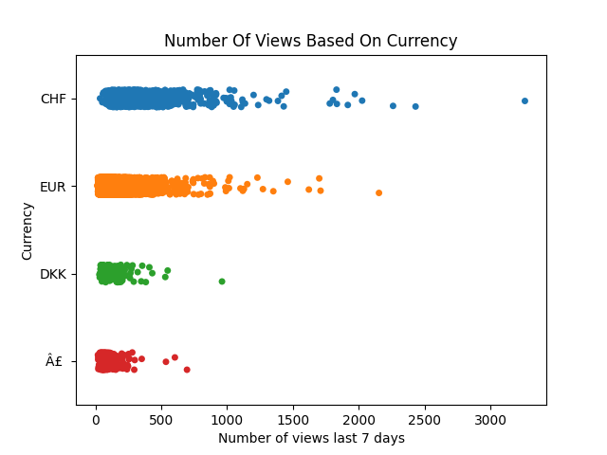
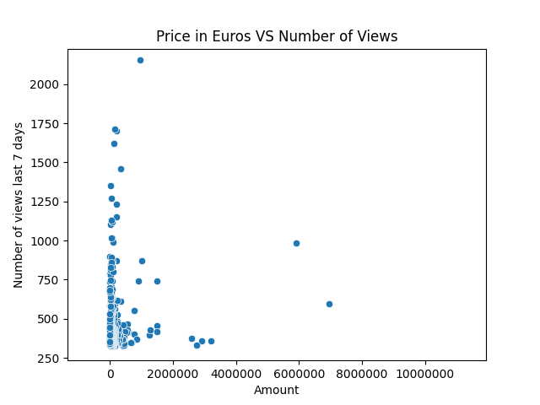
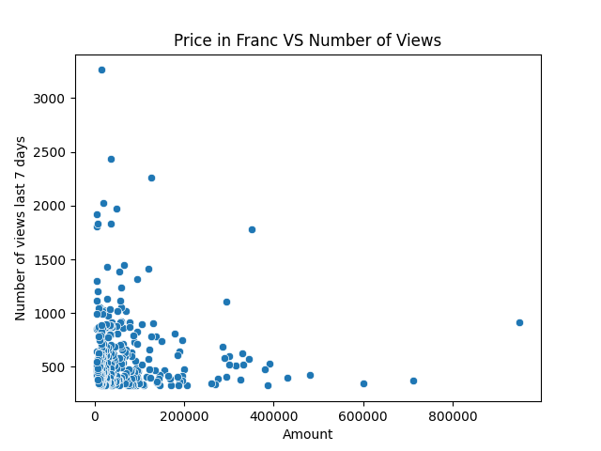
Is it the most expensive boats that get the most views?
About 85% of prices are in Euros (EUR), and about 10% are in Swiss Franc (CHF).
Figure 2
Figure 1
Most viewed Priced in Euros ranges between 3500 and 3,650,000
Most viewed Priced in Francs ranges between 3600 and 2,250,000
Figure 3

Slide 3
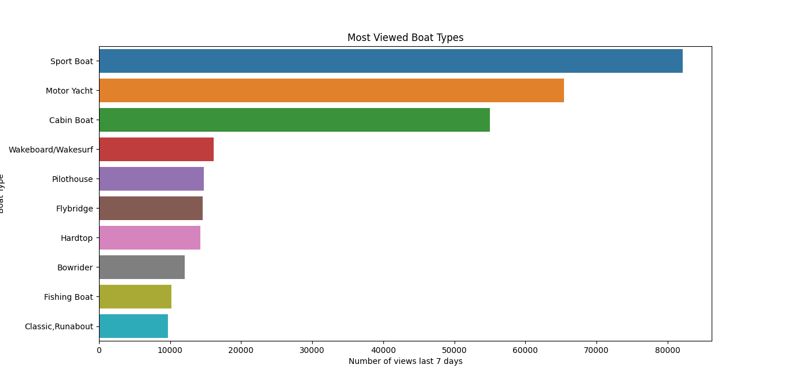
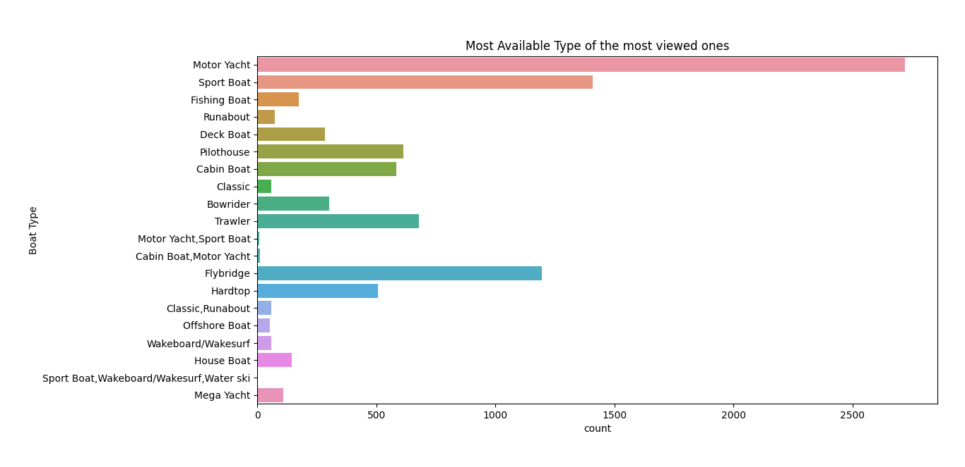
Are there common features among the most viewed boats?
1- Boat Type
Figure 4
Figure 5
The top 3 viewed boat types are 'Sport Boat', 'Motor Yacht', 'Cabin Boat’.
The most available 3 boat types are ‘'Motor Yacht’, ‘'Sport Boat’, ‘Flybridge’.
So, 'Sport Boat’ and 'Motor Yacht’ types are the ideal types to focus on!

Slide 4
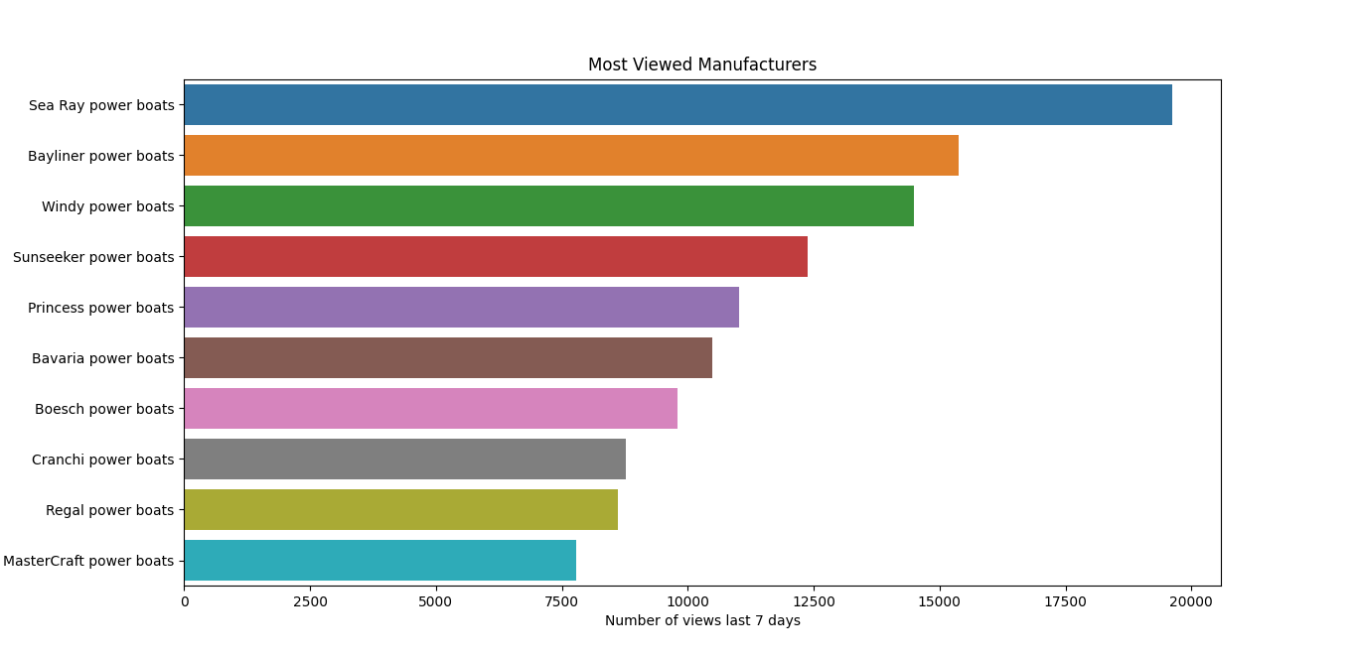
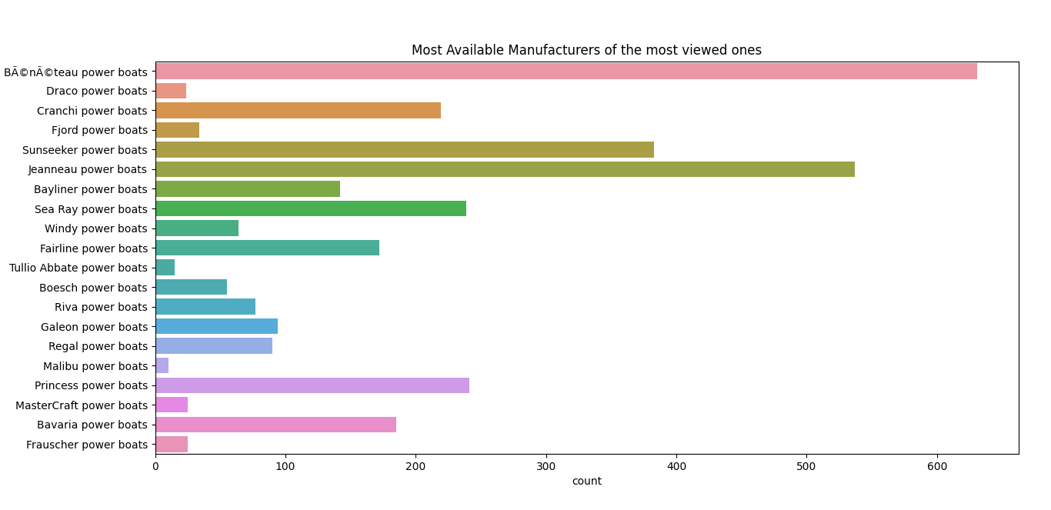
Are there common features among the most viewed boats?
2- Manufacturer
Figure 6
Figure 7
‘Sea Ray power boats’ is the most viewed manufacturer.
‘BÃ©nÃ©teau power boats’ is the Manufacturer of the most available boats, But his boats has almost no views compared to the top 25% viewed boats.
So, ‘sea Ray power boats’ and ‘BayLiner Power boats’ Manufactures are the ideal to focus on!

Slide 5
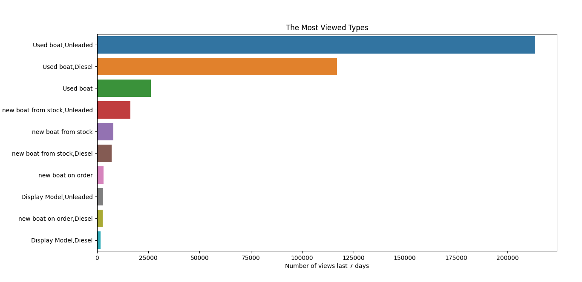
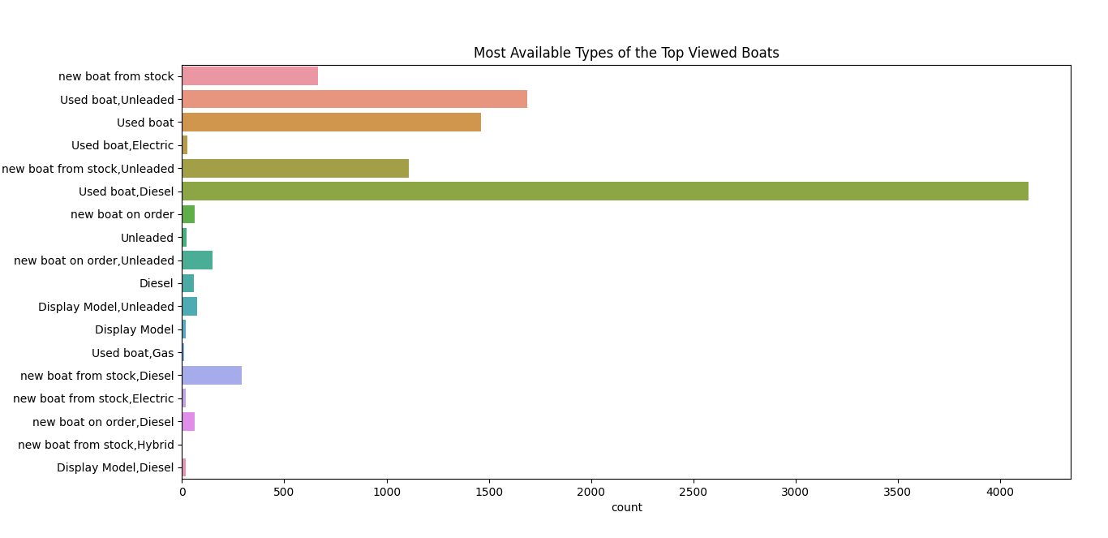
Are there common features among the most viewed boats?
3- Type
Figure 8
Figure 9
‘Used boat,Unleaded’ and ‘Used boat,Diesel’ are the most viewed types.
‘Used boat,Diesel’ and ‘Used boat,Unleaded’ are the most available types too.
So, ‘Used boat,Unleaded’ and ‘Used boat,Diesel’ types are the ideal to focus on!

Slide 6
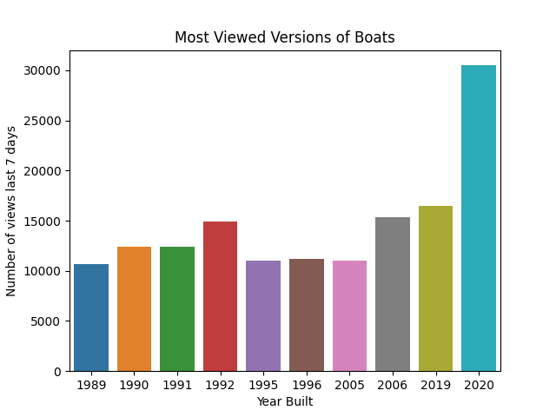
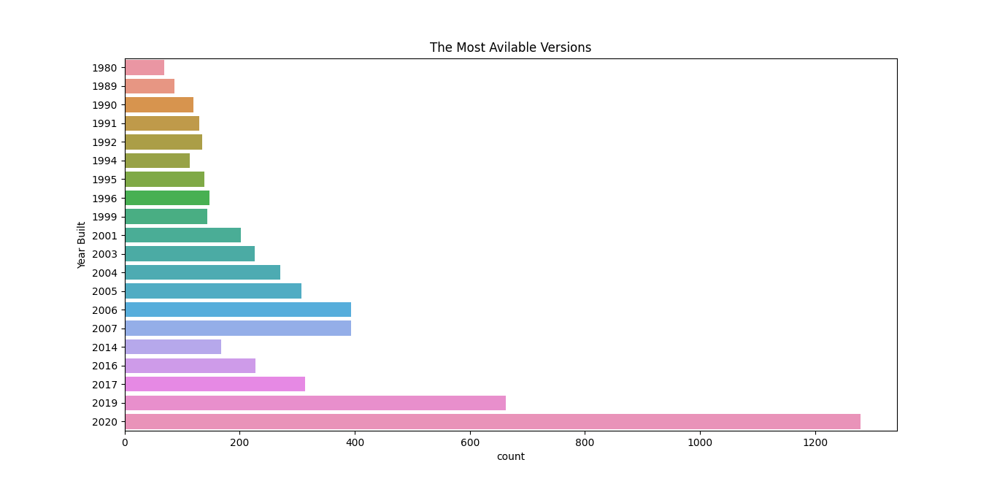
Are there common features among the most viewed boats?
4- Year Built
Figure 10
Figure 11
Boats built in 2020 and 2019 are the most viewed and available boats.
So, Boats built in 2020, 2019 are the most ideal boats to focus on!

Slide 7
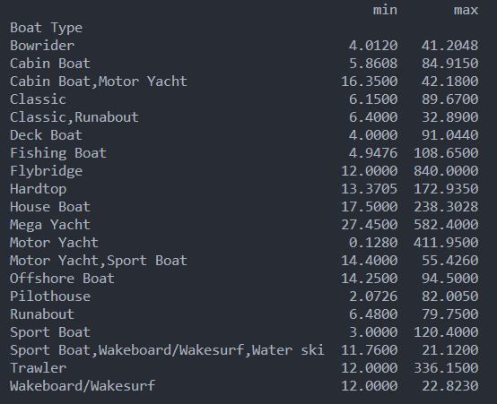
Are there common features among the most viewed boats?
5- Area
The most viewed area depends on the type of the boat.
The table in figure 12 shows the range of the most viewed boats’ areas for each type.
Figure 12

Slide 8
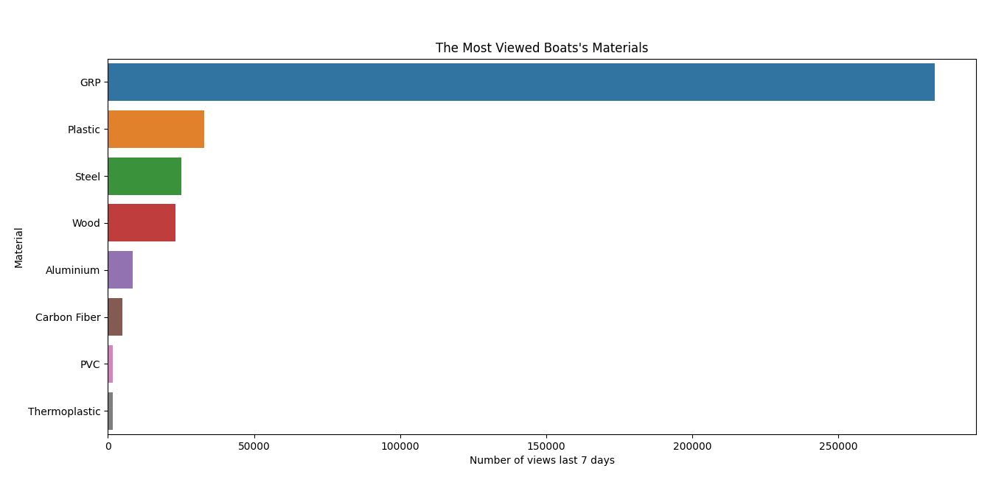
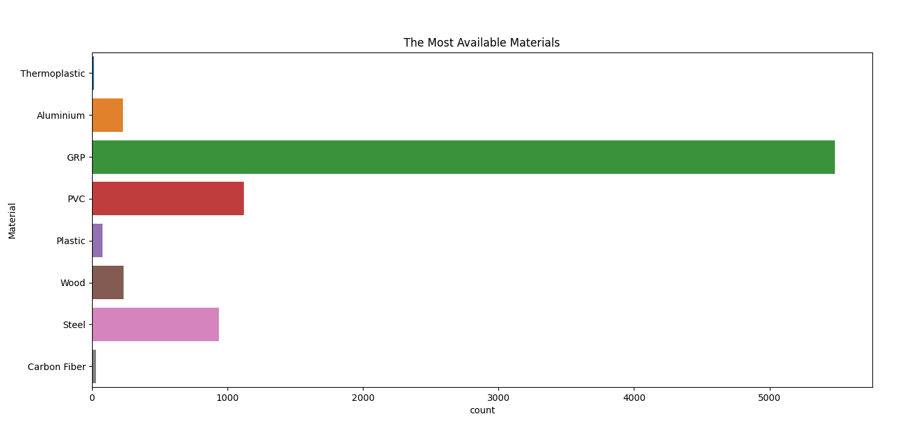
Are there common features among the most viewed boats?
6- Material
Figure 13
Figure 14
Boats built with GRP are the most viewed and available boats.
So, Boats built with GRP are the most ideal boats to focus on!

Slide 9
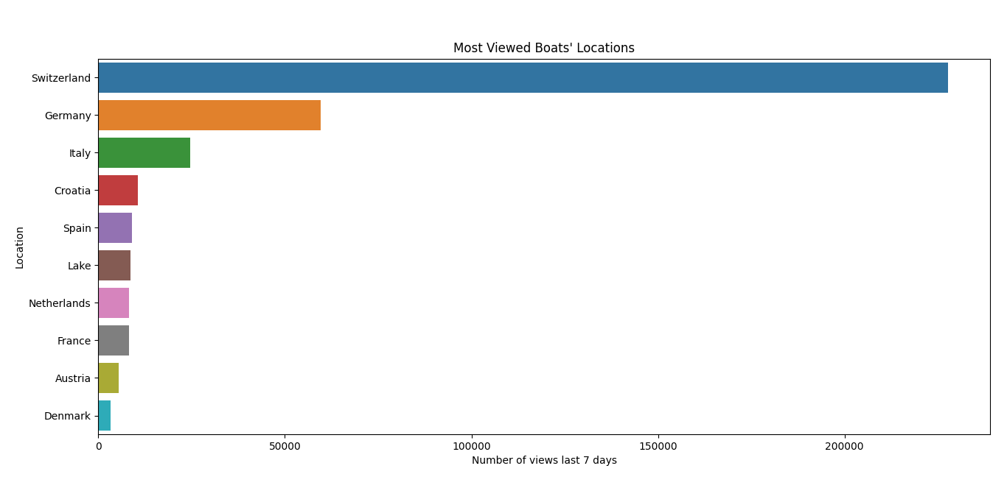
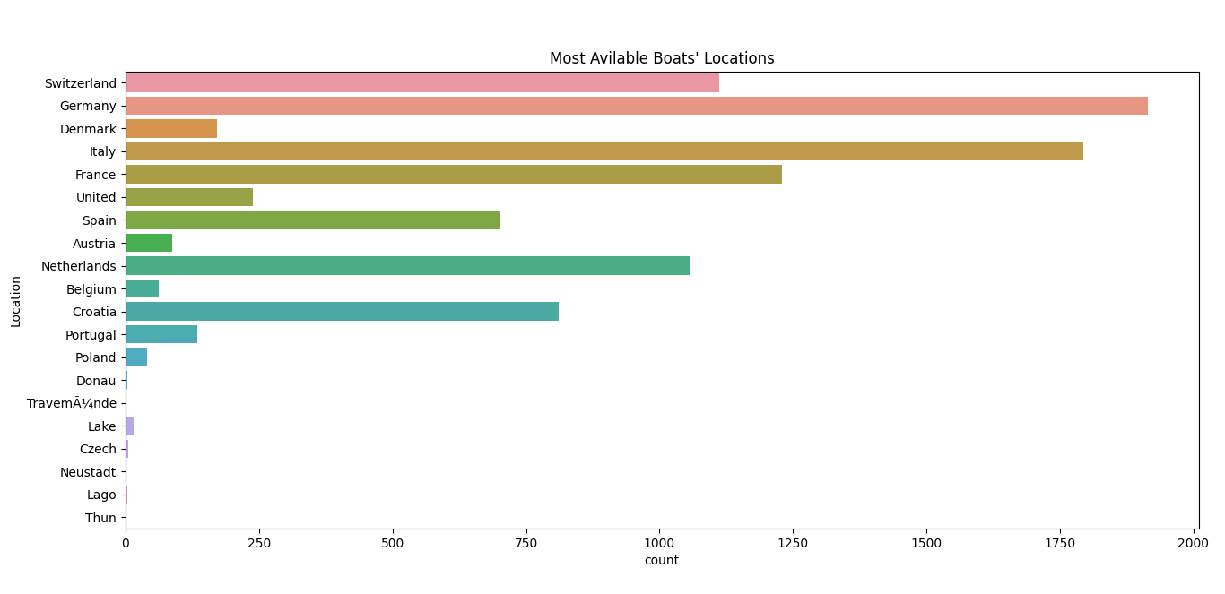
Are there common features among the most viewed boats?
7- Location
Figure 15
Figure 16
Boats in Switzerland, Germany and Italy are the most viewed boats.
But Boats in Germany are the most available, then in Italy, Then in France, then in Switzerland
So, Boats in Switzerland, Germany and Italy are the most ideal boats to focus on!

Slide 10

Random Forest Regressor

Slide 11
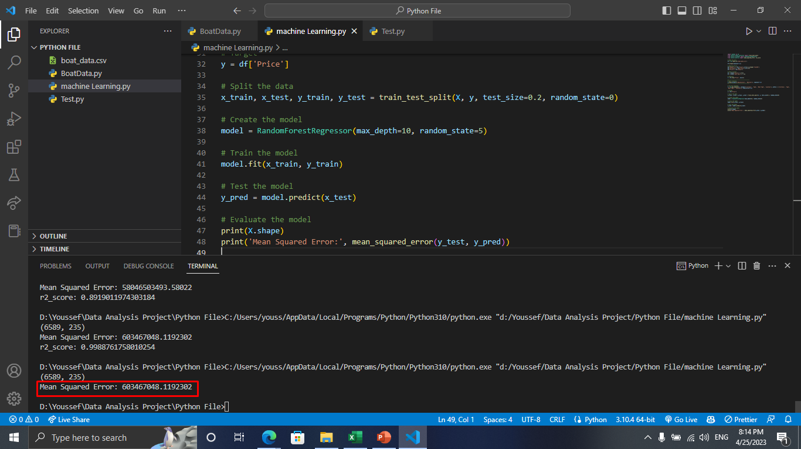
Error Before Handling

Slide 12
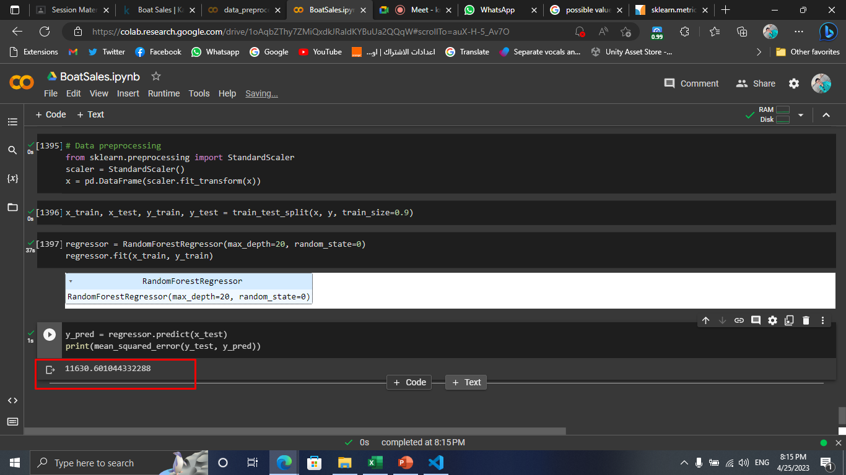
Error After Handling

Slide 13
Thank You

